Slide 1

Plants & Flowers image Identifier
Joe Xing

Slide 2
Overview
Contextual image classification, a topic of pattern recognition in computer vision
Focused on recognizing plants and flowers

Slide 3

Potential values

Slide 4
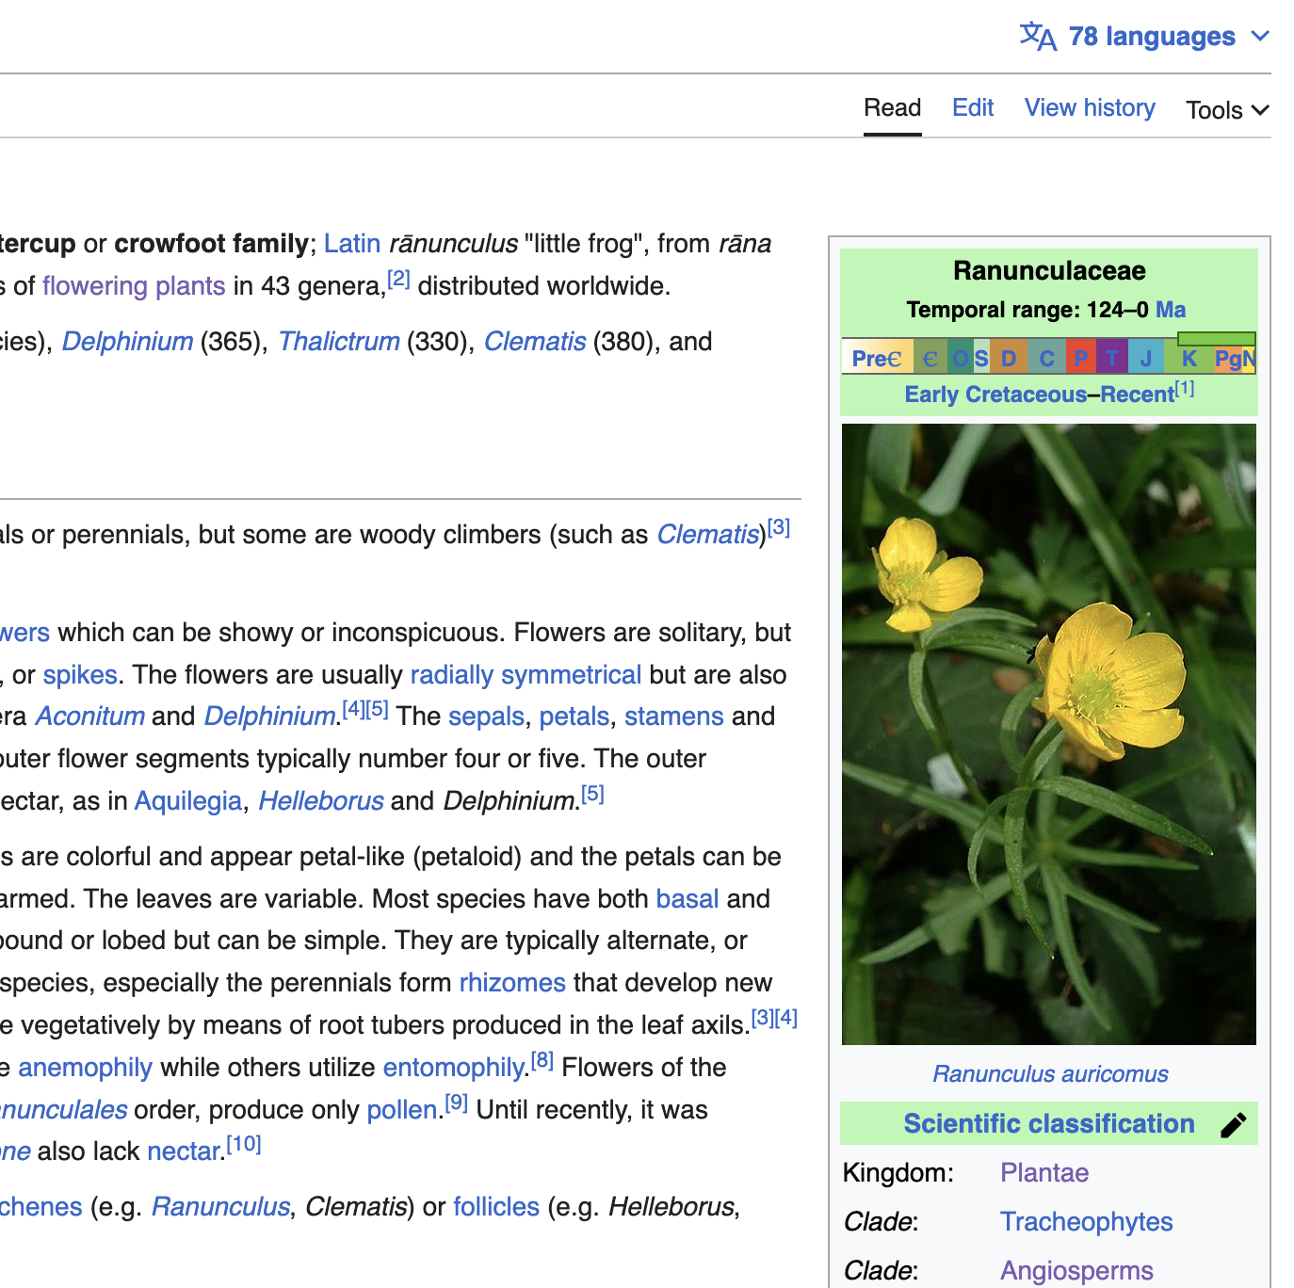
Connect to open-source databases for detailed knowledge of a plant

Slide 5
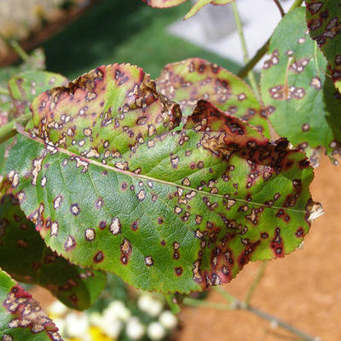
Help detecting plant diseases

Slide 6

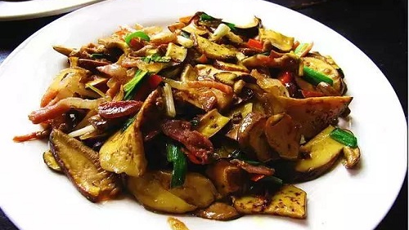
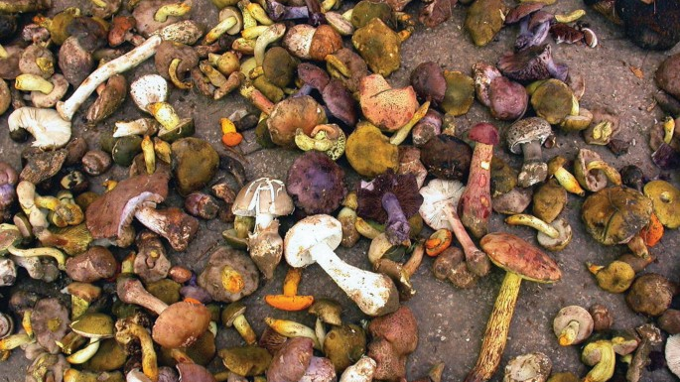
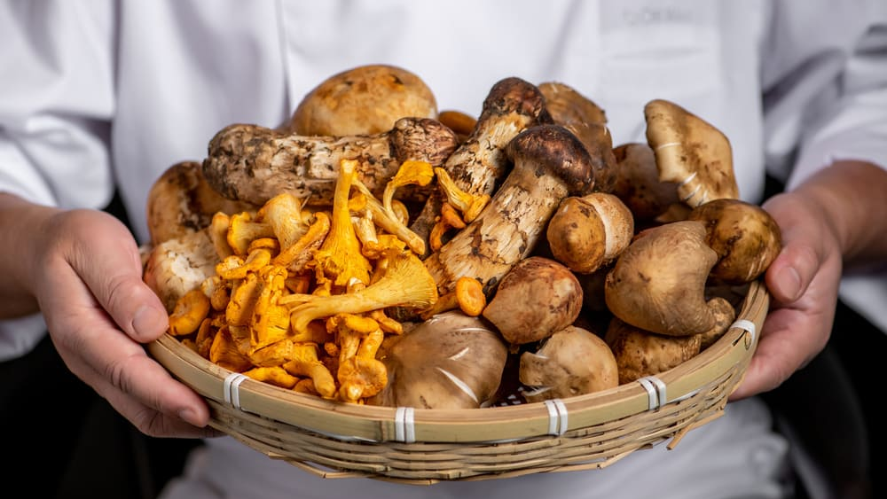

Yunnan sits in the southwest corner of China and is marked by its mountainous terrain. Famous for picking and consuming wild mushrooms。

Slide 7
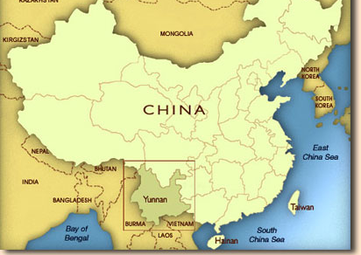
In Yunnan Province from 2010-2018, 9686 people suffered from mushroom toxicity, and 225 of them died from eating wild toxic mushrooms, the rate is 2.32%
Apply this tech to identify edible wild mushroom could help

Slide 8

Sponsored Shop advertisement

Slide 9

Data Science Approach
Data Collection
Data cleaning &wrangling
Train model
Build convolutional network
Augment data(flip the image, generate noise)
Confusion Matrix (To identify the mismatched elements)
Recollect data from user feedbacks to correct model and automate the entire process

Slide 10
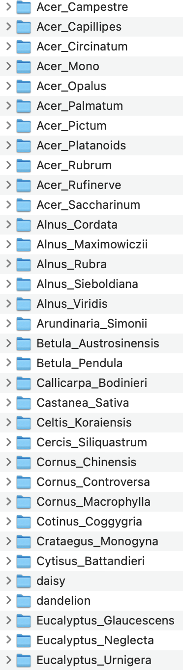


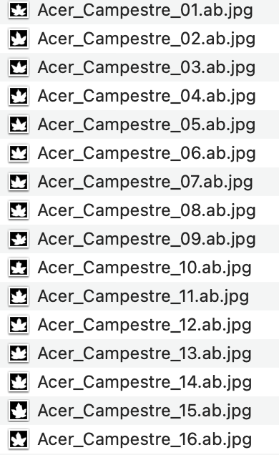
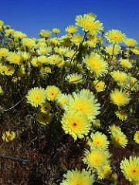
Dataset
There is 100 Classes with 16 images and 5 class uneven number of images I added, 'dandelion': 1052, 'rose': 784,'tulip': 984,'daisy': 764,'sunflower': 733, the class with 16 pictures are all Black and white photos, and the 5 classes I added is colored photo.

Slide 11
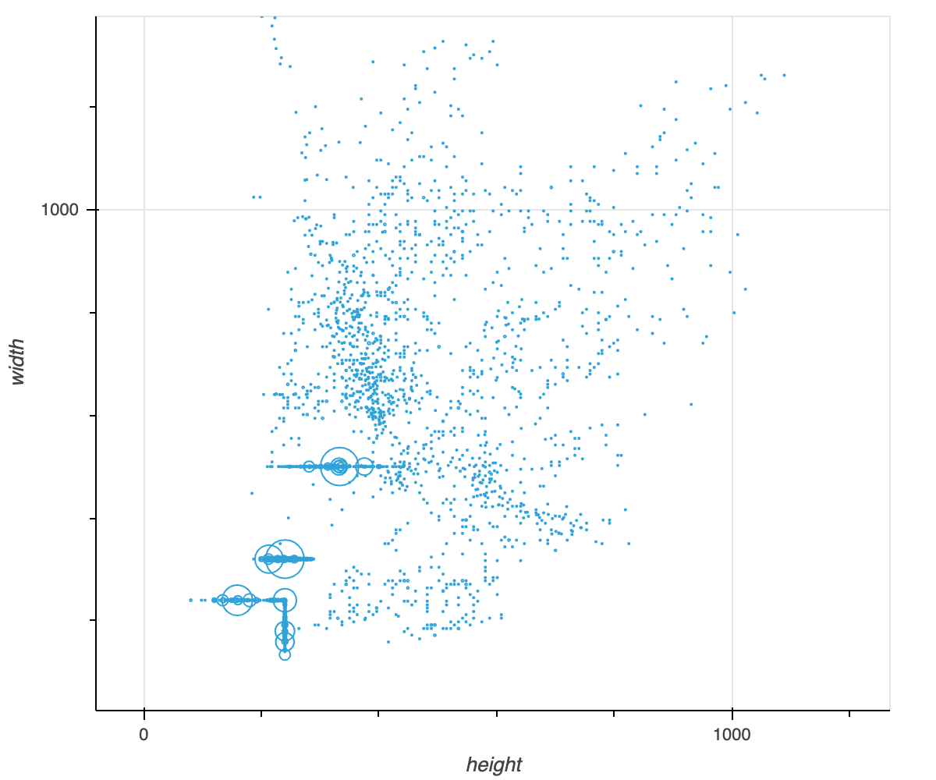
EDA insights
Most image falls into the 1000*1000(Height * Width) frame, and we see there several large clusters, for example, there are 219 images of size 240x240, there are 604 images of size 240x320.

Slide 12
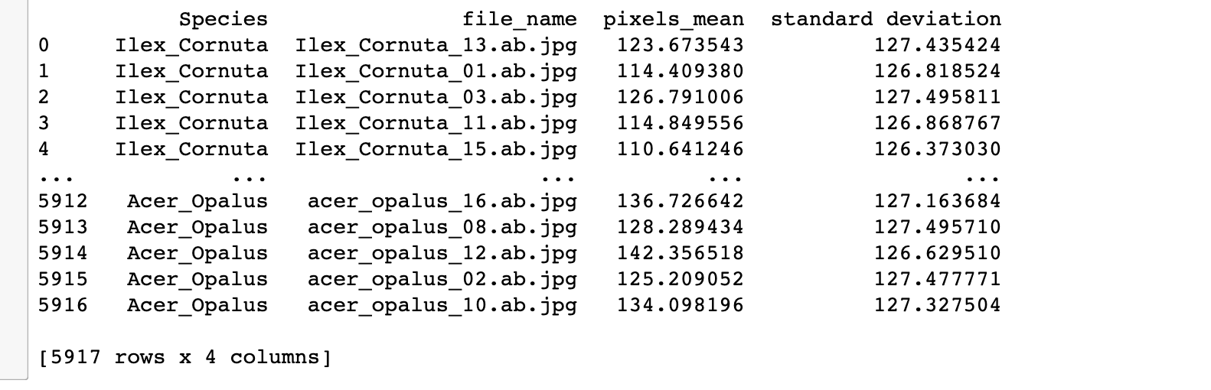
Next steps
Constructed a data frame record the name of each file, the class it belongs to and its mean and standard deviation. Constructing this data frame for further analysis, it could be use testing the relation between the variance of the color pixels and the accuracy of the future machine learning model.

Slide 13
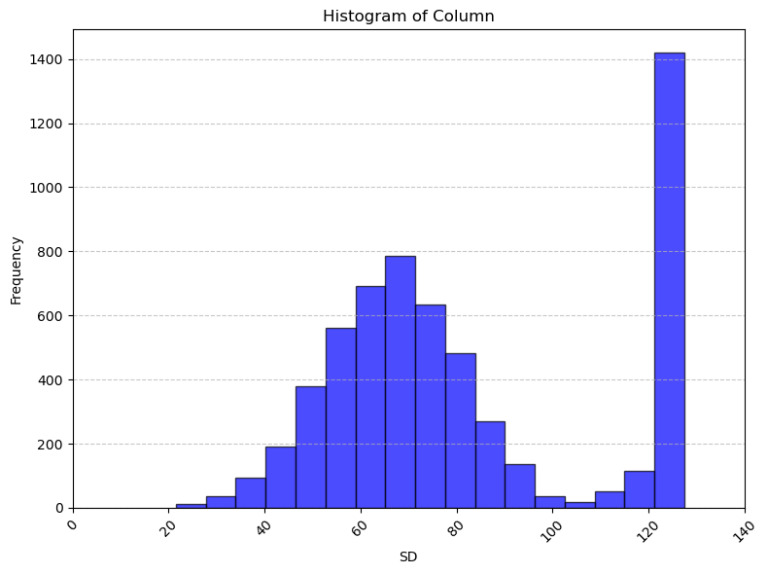
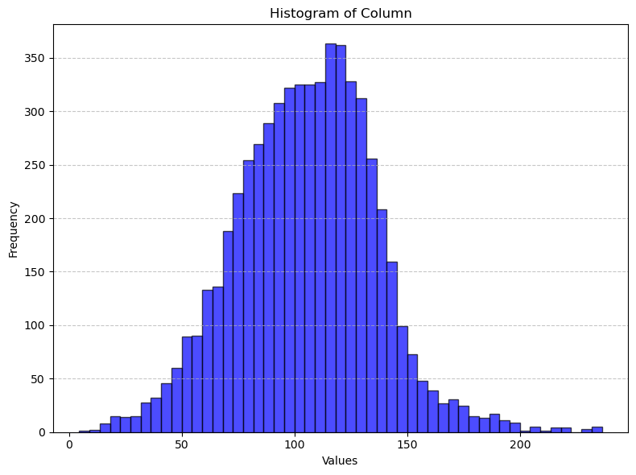
EDA insights

Slide 14
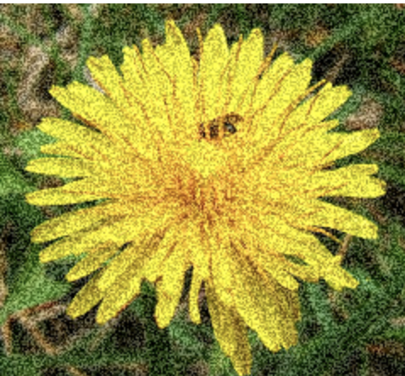
Next steps
Image augmentation, flipping, generating random noise on photo.
Train test split
Building image baseline models

